Slide 1


Minglu Zeng
10/14/2022

Slide 2

Outline
Executive Summary
Introduction
Methodology
Results
Conclusion
Appendix

Slide 3
Executive Summary
Summary of methodologies
Data Collection through API
Data Collection with Web Scraping
Data Wrangling
Exploratory and Preparing Data
Exploratory Data Analysis: with sql, with Data Visualization, with Folium, with Plotly Dash
Machine Learning Prediction: Logistic Regression, Support Vector Machine, Decision Tree, KNN
Summary of all results
Exploratory Data Analysis result
Predictive Analytics result using classification models

Slide 4
Introduction
Project background and context
According to data released by SpaceX, the Falcon9 rocket costs $62million while other companies often spend more than $165million for a launch. The reason SpaceX can be able to go so much lower is because it can reuse the first stage rocket. If we can calculate the cost of launch by predicting whether the first stage will land, other companies can use that information. In this project, we can use machine learning to predict whether the first stage of SpaceX will land or not
Problems you want to find answers
Which factors determine the successful rate of landing?
What should be the operating conditions of a successful landing?

Slide 5

Section 1

Slide 6
Methodology
Executive Summary
Data collection methodology:
How data was collected with API and Web Scrapping
Perform data wrangling
How data was processed with one hot encoded
Perform exploratory data analysis (EDA) using visualization and SQL
Scatter plot, line plot and bar plot
Perform interactive visual analytics using Folium and Plotly Dash
Folium and Plotly Dash
Perform predictive analysis using classification models
How to build, tune, evaluate classification models

Slide 7
Data Collection
Data sets are collected using the API call from SpaceX Websites.
Data collected using API
Convert to Data Frame by JSON
Pre-Processing
Filter data
Convert to CSV

Slide 8
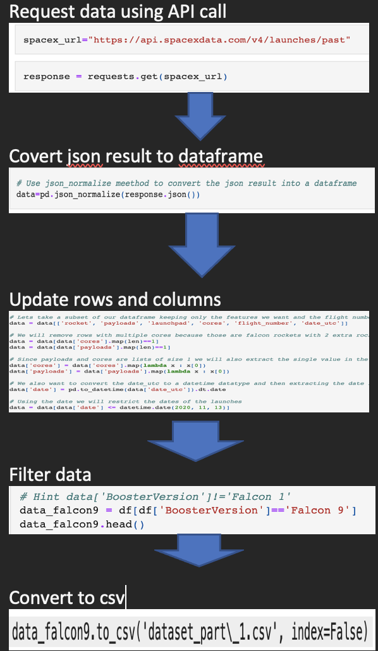
Data Collection – SpaceX API
Data collection using API call
https://github.com/mingluzeng/spaceX_assignment/blob/main/jupyter-labs-spacex-data-collection-api.ipynb

Slide 9
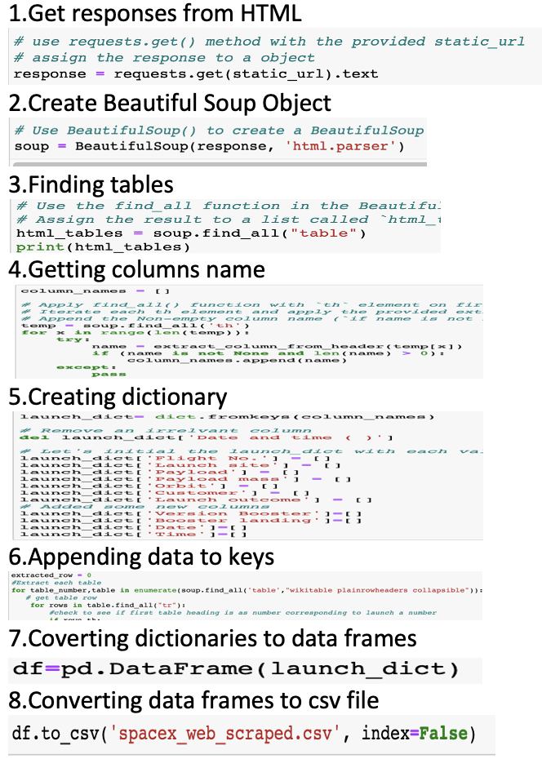
Data Collection - Scraping
Falcon 9 historical launch records collected by web scraping with BeautifulSoup
https://github.com/mingluzeng/spaceX_assignment/blob/main/jupyter-labs-webscraping.ipynb
Place your flowchart of web scraping here

Slide 10
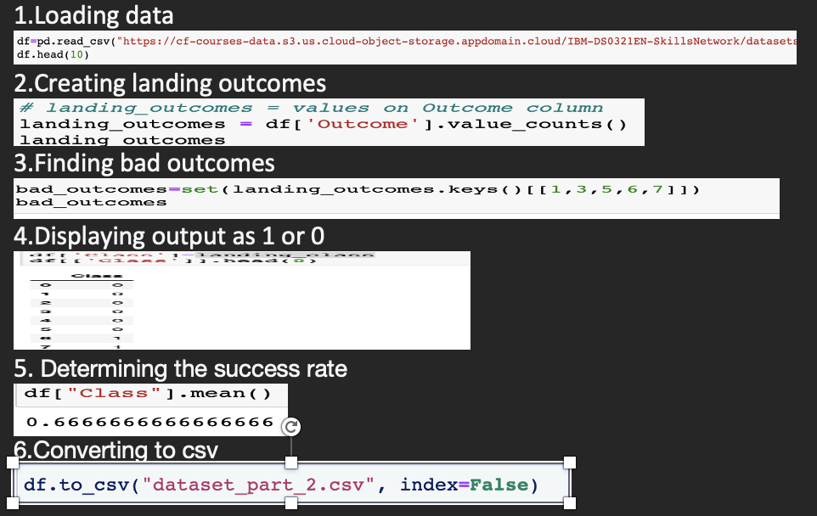
Data Wrangling
Performed Exploratory data analysis
Calculated the number of launches of each site, orbit occurrence and mission
Created class label to calculate successful rate
https://github.com/mingluzeng/spaceX_assignment/blob/main/labs-jupyter-spacex-Data wrangling.ipynb

Slide 11
EDA with Data Visualization
https://github.com/mingluzeng/spaceX_assignment/blob/main/jupyter-labs-eda-dataviz.ipynb
We visualized relationship between successful rate and Launch Site, the relationship between the number of flights and launch sites, the relationship between Payload and Launch Site, the relationship between number of flights and Orbit type by scatter plot chat
We visualized the relationship between success rate of each orbit type by bar chat
We observed launch success yearly trend by line chart

Slide 12
EDA with SQL
the SQL queries I performed
The names of the unique launch sites in the space mission
5 records where launch sites begin with the string 'CCA’
The total payload mass carried by boosters launched by NASA (CRS)
Average payload mass carried by booster version F9 v1.1
The date when the first successful landing outcome in ground pad was acheived.
The names of the boosters which have success in drone ship and have payload mass greater than 4000 but less than 6000
The total number of successful and failure mission outcomes
The booster_versions which have carried the maximum payload mass
The failed landing_outcomes in drone ship, their booster versions, and launch site names for in year 2015
The count of landing outcomes (such as Failure (drone ship) or Success (ground pad)) between the date 2010-06-04 and 2017-03-20 in descending order
https://github.com/mingluzeng/spaceX_assignment/blob/main/Spacex (1).ipynb

Slide 13
Build an Interactive Map with Folium
Mark all launch sites on a folium map
Mark the success/failed launches for each site on the map
Calculate the distances between a launch site to its proximities
https://github.com/mingluzeng/spaceX_assignment/blob/main/lab_jupyter_launch_site_location.ipynb

Slide 14
Build a Dashboard with Plotly Dash
We built an interactive dashboard with Plotly dash
We displayed the total launches by a certain sites by pie chart
We plotted scatter graph displayed the relationship with Outcome and Payload Mass (Kg) for the different booster version by plotted scatter.
https://github.com/mingluzeng/spaceX_assignment/blob/main/Ploty_Dash.py

Slide 15
Load data
Split data into Test and Train set
Build machine Learning(LR,SVM,DecisionTree,knn)
To get the best parameters for each mode with GridSearchCV
Predictive Analysis (Classification)
https://github.com/mingluzeng/spaceX_assignment/blob/main/SpaceX_Machine Learning Prediction_Part_5.ipynb

Slide 16
Results
Each launch site has different successful rate. And KSC LC-39A has the highest successful rate which is 76.9%.
The successful rate of lighter Payload is higher than heavier Payload
ES-L1, GEO, HEO, SSO have the highest success rate
The successful rate increased significantly in 2013
Decision Tree Classifier has the highest score among four type machine learning

Slide 17

Section 2

Slide 18
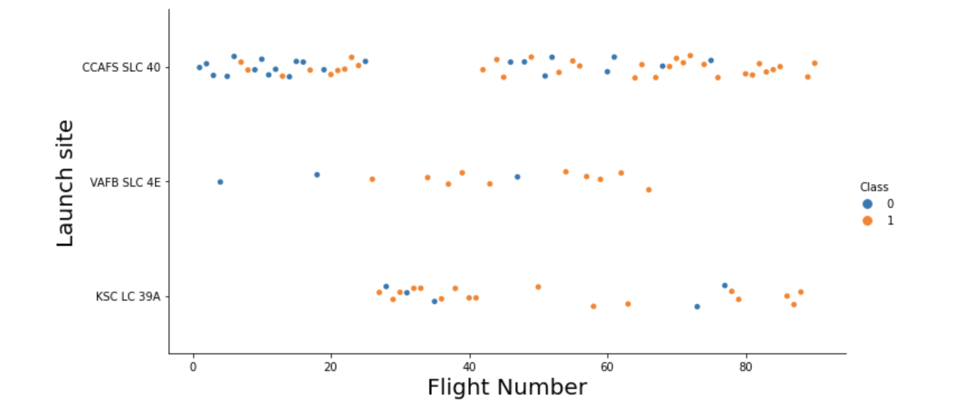
Flight Number vs. Launch Site
Launch site of CCAFS SLC 40 is significantly higher than others
The larger the flight amount at a launch site, the greater the success rate at a launch site.

Slide 19
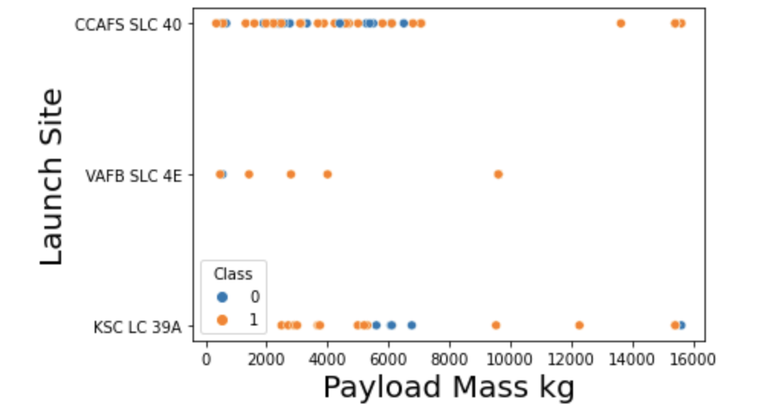
Payload vs. Launch Site
The Majority of loads with lower mass are launched from CCAFS SLC 40
There is no heavy payload(more than 1000KG of VAFB SLC 4E)

Slide 20
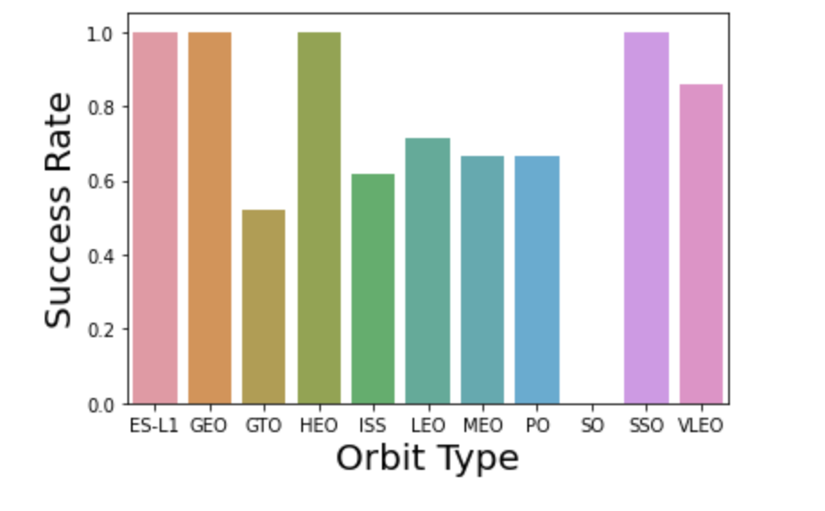
Success Rate vs. Orbit Type
ES-L1, GEO, HEO, SSO have the highest success rate

Slide 21
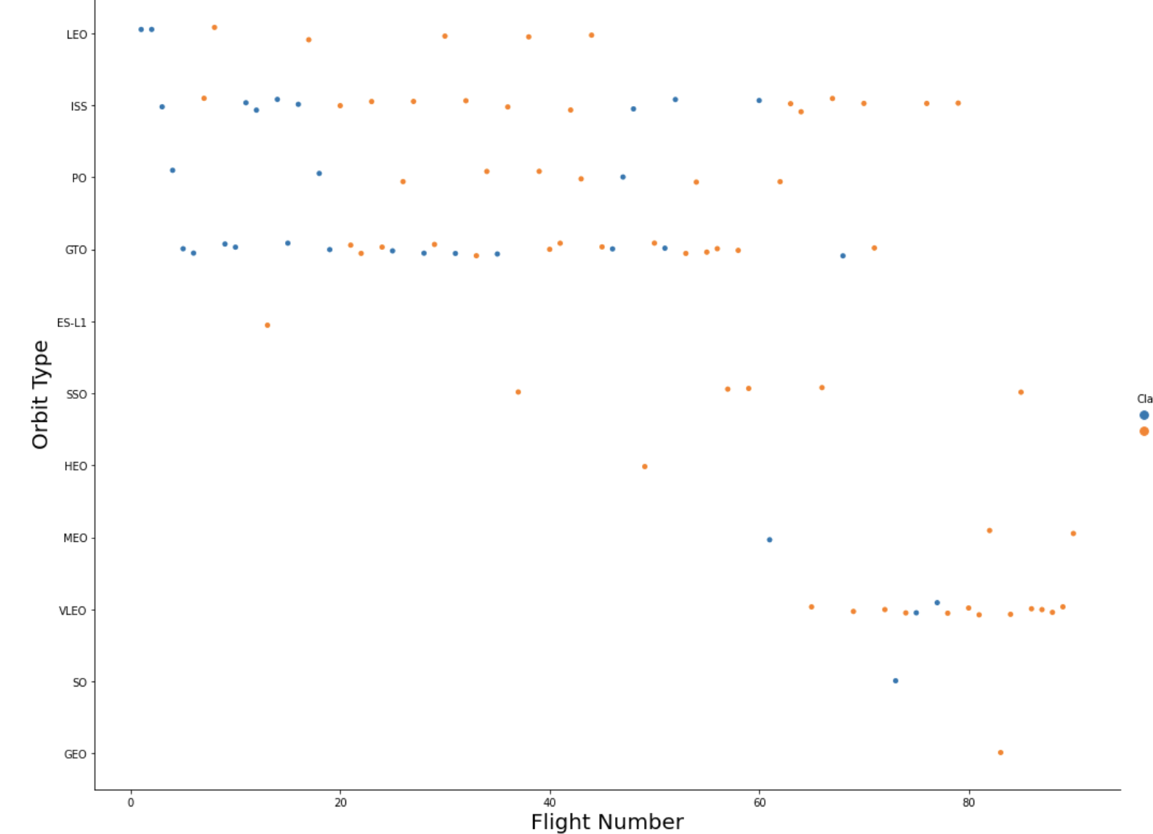
Flight Number vs. Orbit Type
It displayed successful rate is related to the number of flights in the LEO orbit, and there is no obvious relationship between flight number and the orbit in the GTO orbit

Slide 22
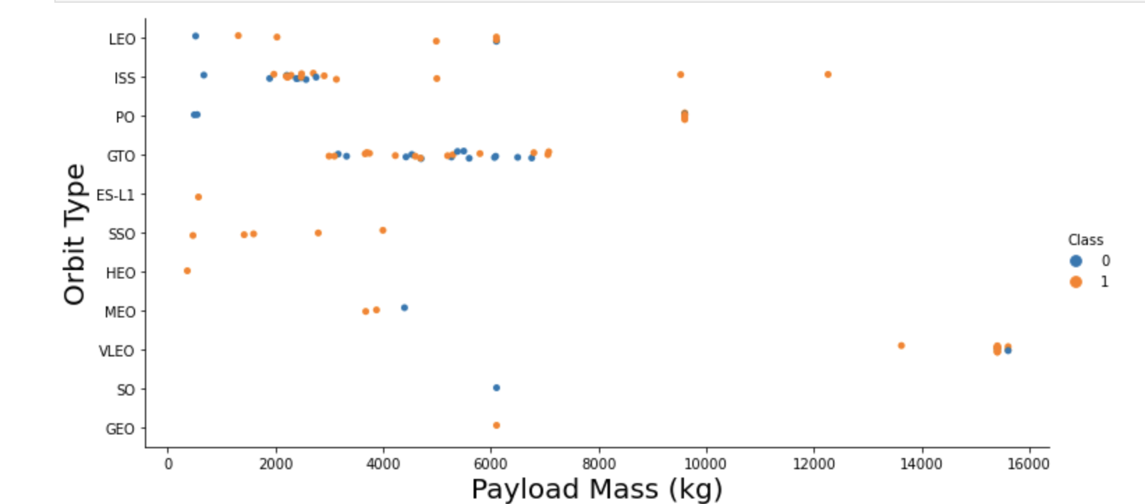
Payload vs. Orbit Type
We can observe the strong correlation between ISS and Playload from 2000 to 3000, and GTO from 3000 to 8000

Slide 23
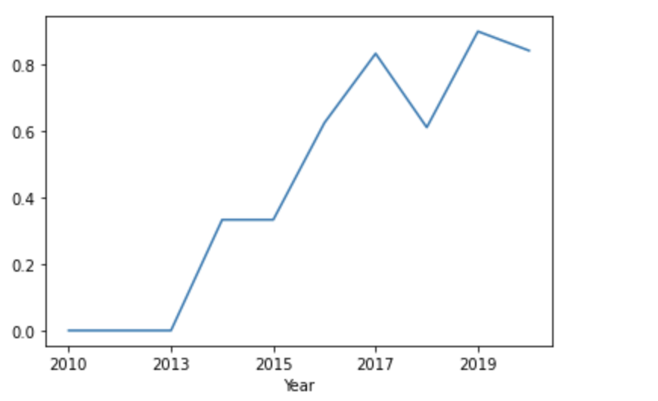
Launch Success Yearly Trend
you can observe that the Success rate since 2013 kept increasing till 2020

Slide 24
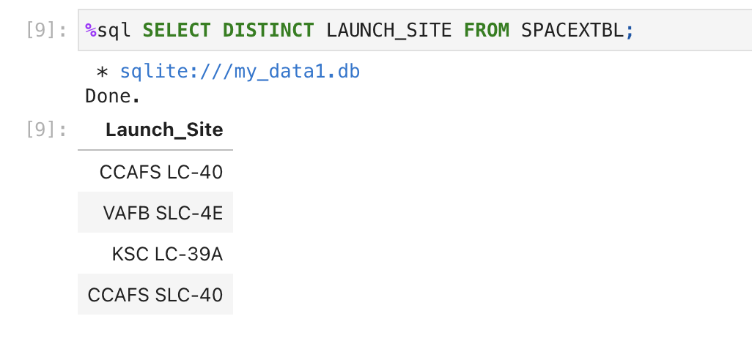
All Launch Site Names
There are 4 launch sites

Slide 25
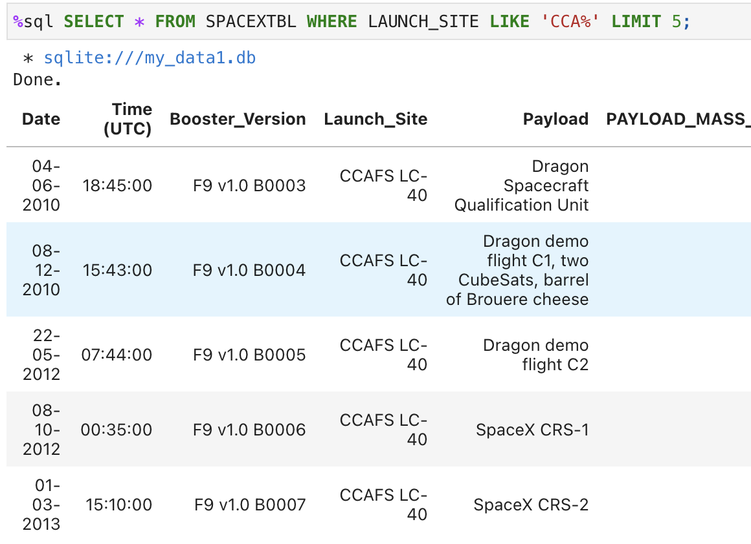
Launch Site Names Begin with 'CCA'
Display 5 records where launch sites begin with the string 'CCA'

Slide 26
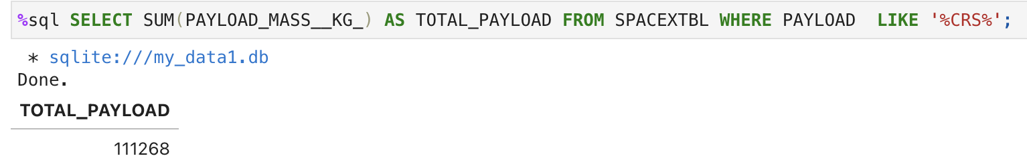
Total Payload Mass
Display the total payload mass carried by boosters launched by NASA (CRS)

Slide 27
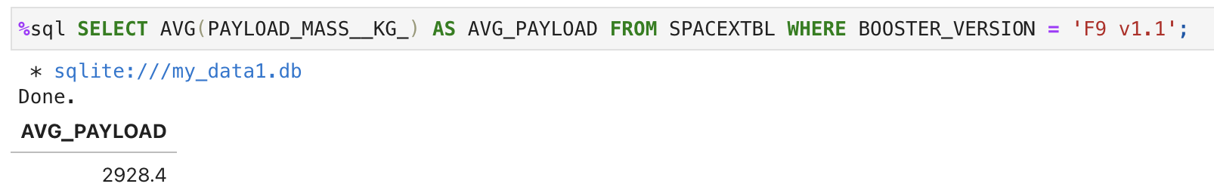
Average Payload Mass by F9 v1.1
Display average payload mass (kg) carried by booster version F9 v1.1

Slide 28
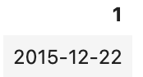
First Successful Ground Landing Date
The date when the first successful landing outcome in ground pad was 2015-12-22.

Slide 29
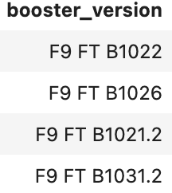
Successful Drone Ship Landing with Payload between 4000 and 6000
List the names of the boosters which have success in drone ship and have payload mass greater than 4000 but less than 6000

Slide 30
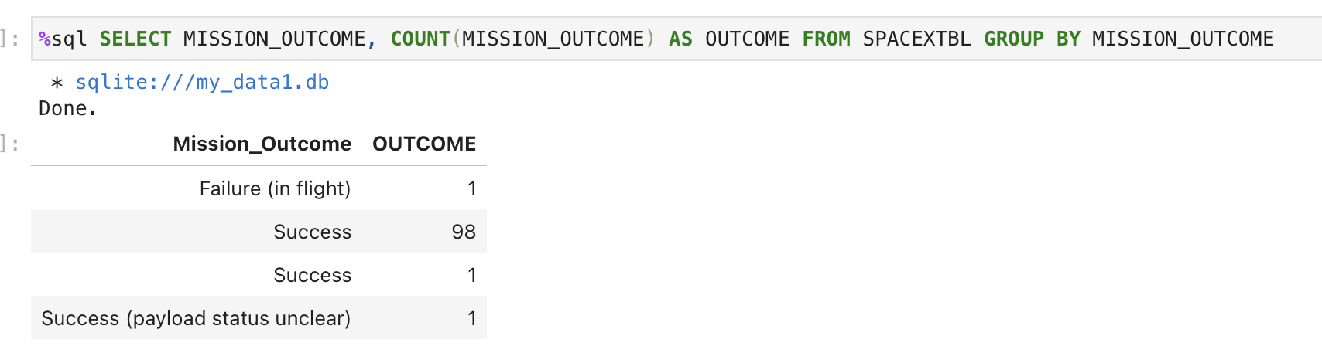
Total Number of Successful and Failure Mission Outcomes
List the total number of successful and failure mission outcomes

Slide 31
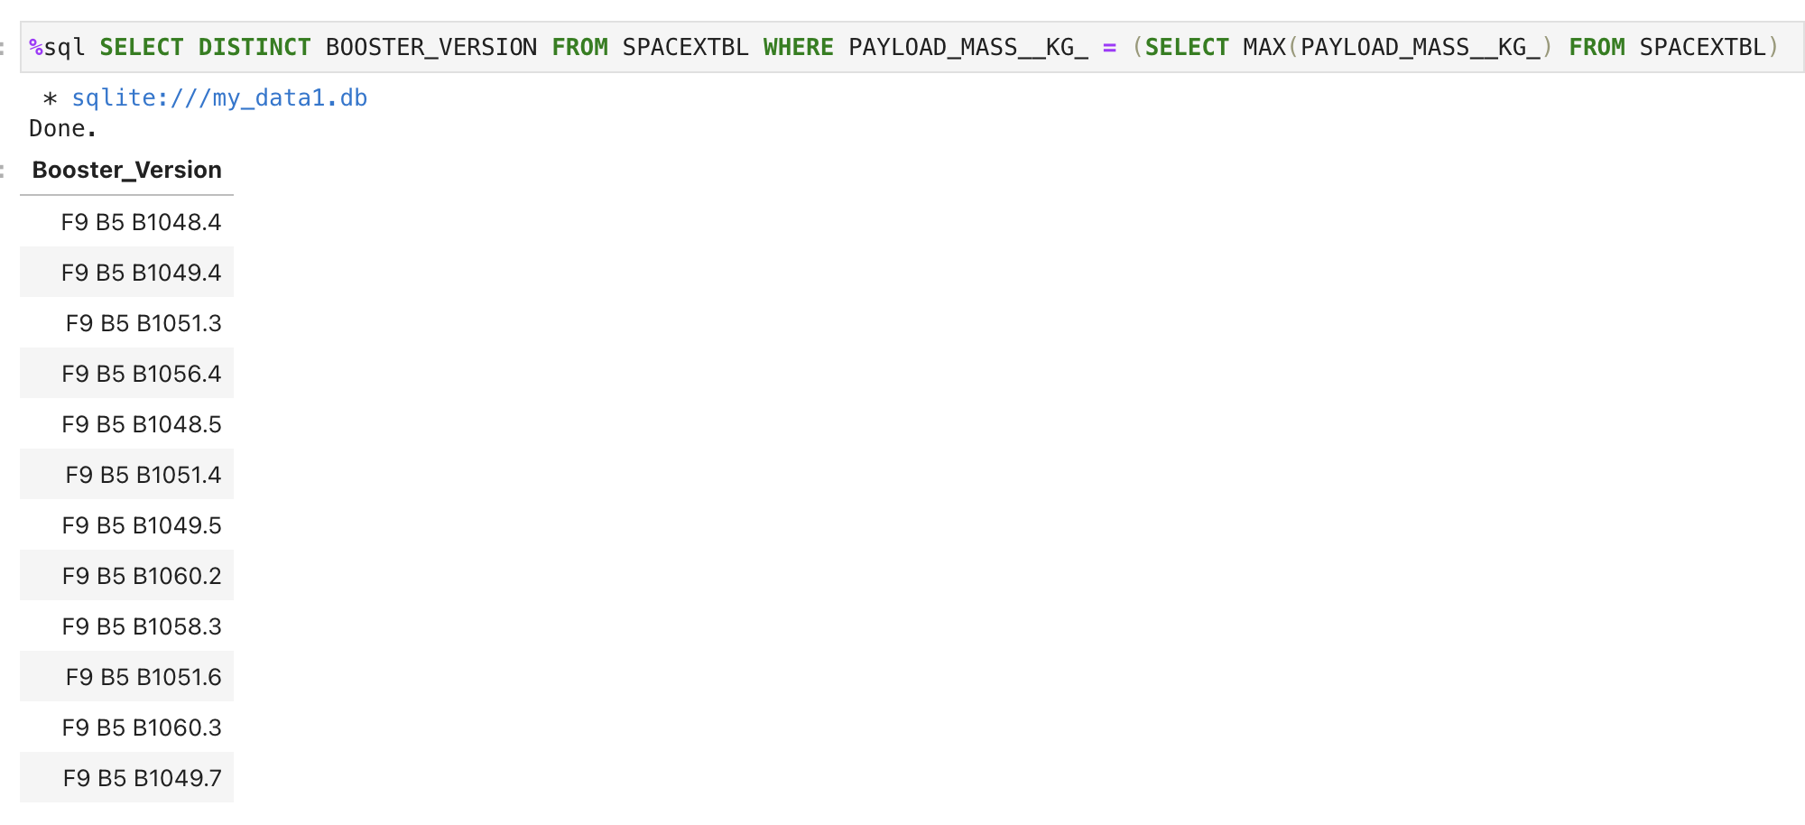
Boosters Carried Maximum Payload
The names of the booster_versions which have carried the maximum payload mass.

Slide 32
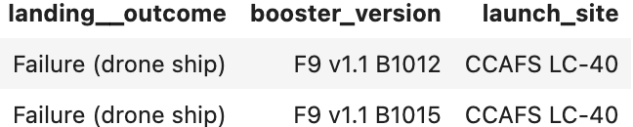
2015 Launch Records
The failed landing_outcomes in drone ship, their booster versions, and launch site names for in year 2015

Slide 33
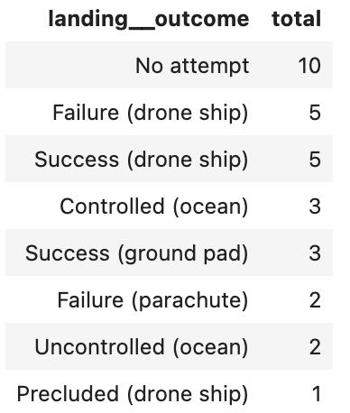
Rank Landing Outcomes Between 2010-06-04 and 2017-03-20
Rank the count of landing outcomes (such as Failure (drone ship) or Success (ground pad)) between the date 2010-06-04 and 2017-03-20, in descending order

Slide 34

Section 3

Slide 35
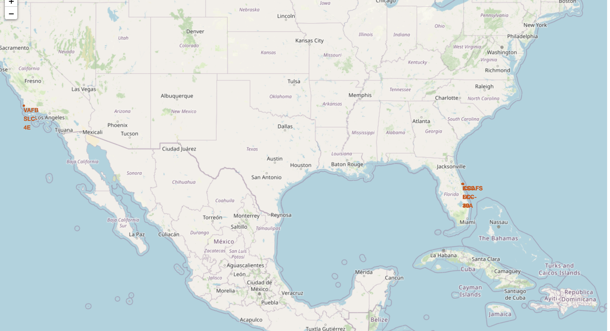
All Launch sites
launch sites are often located off the coast

Slide 36
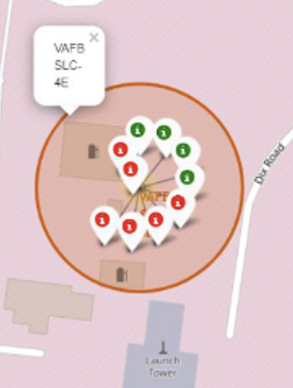
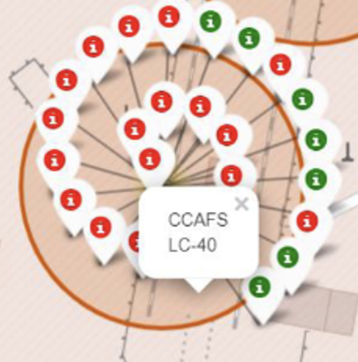
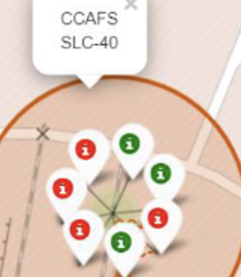
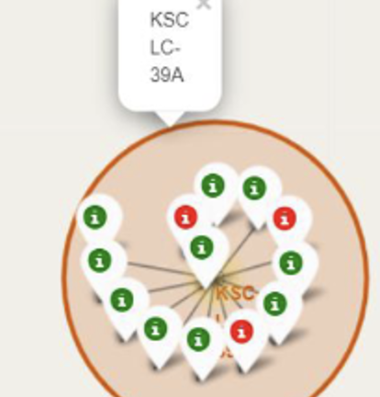
The success/failed launch sites
The green markers means successful, and the red markers means failed
California Launch site
Florida Launch sites

Slide 37
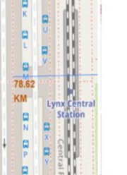
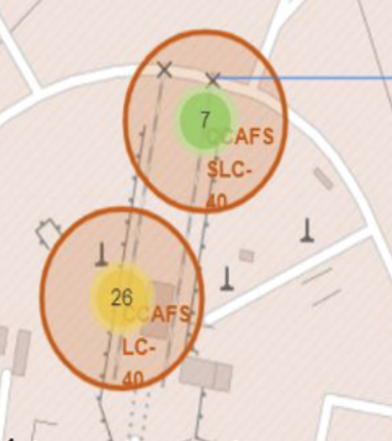
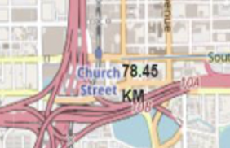
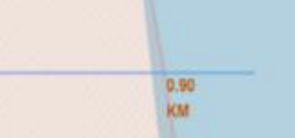
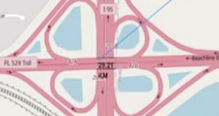
The Distances Between a Launch Site to Its Proximities
Launch sites are in close to coastline, and keep certain distance away from railways, highway and cities.
highway
Coastline
railway
Coast
City

Slide 38

Section 4

Slide 39
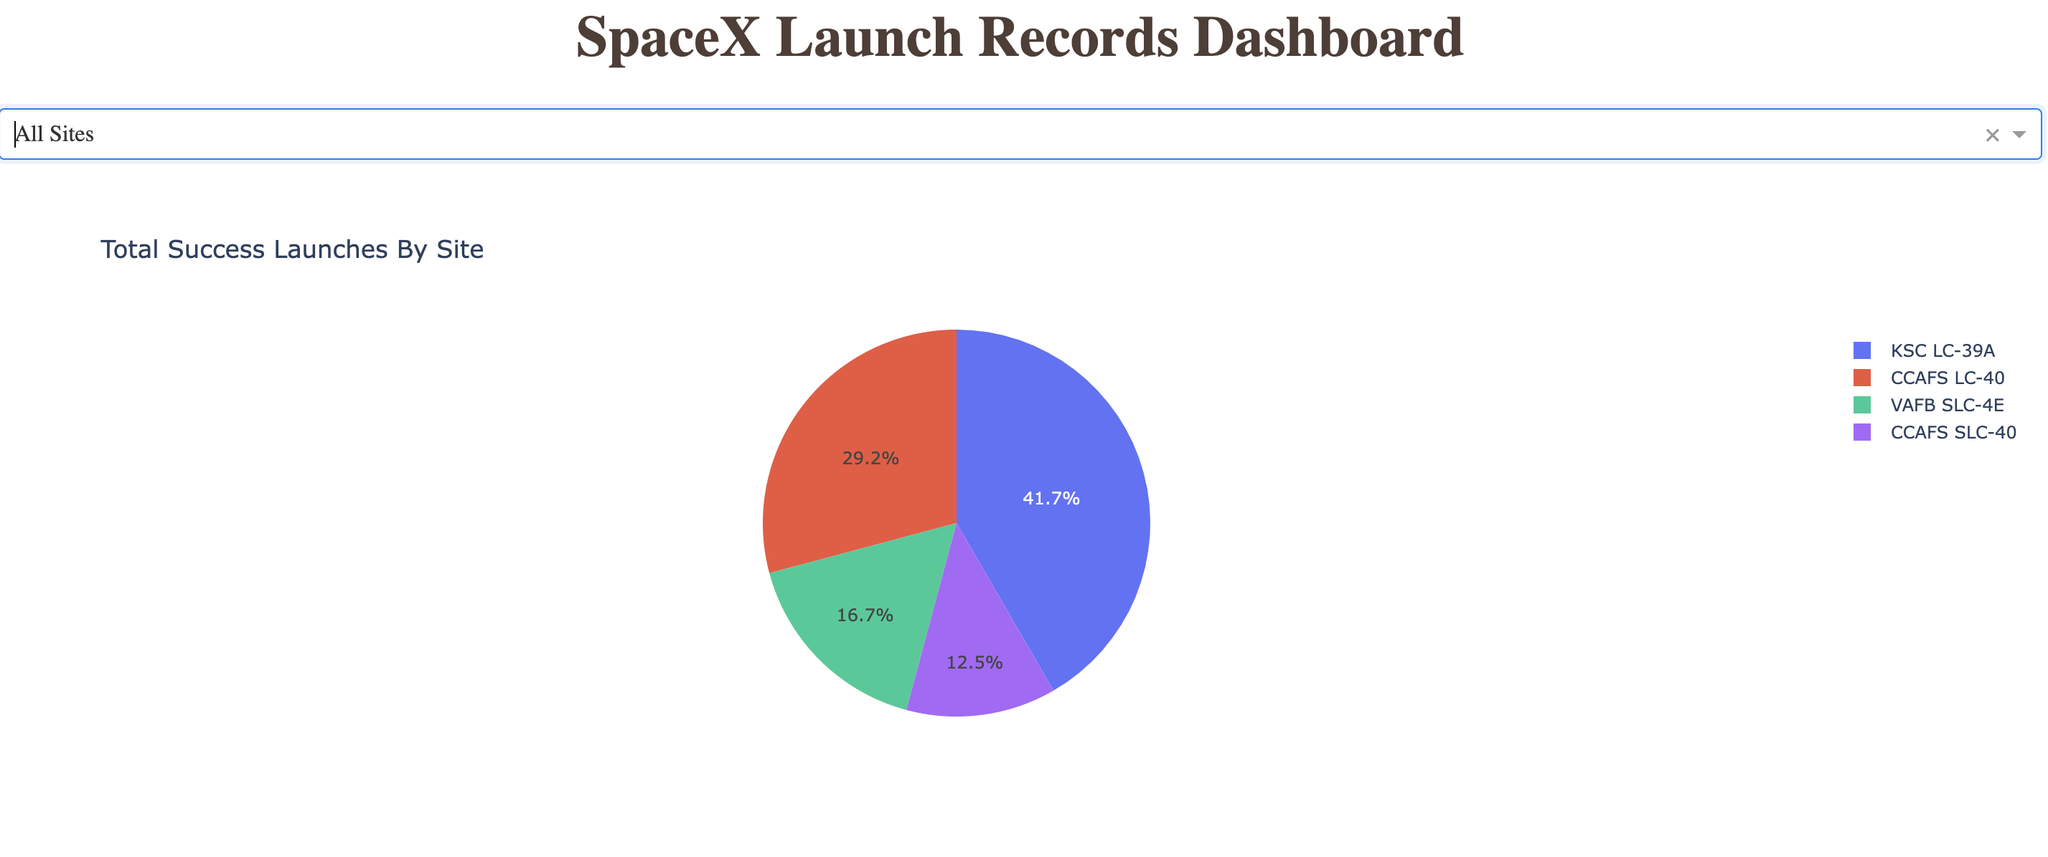
The site with the highest percentage of successful launches is KSC LC-39A(41.7%), and the with the lowest percentage of successful launches is CCAFS SLC-40(12.5%)

Slide 40
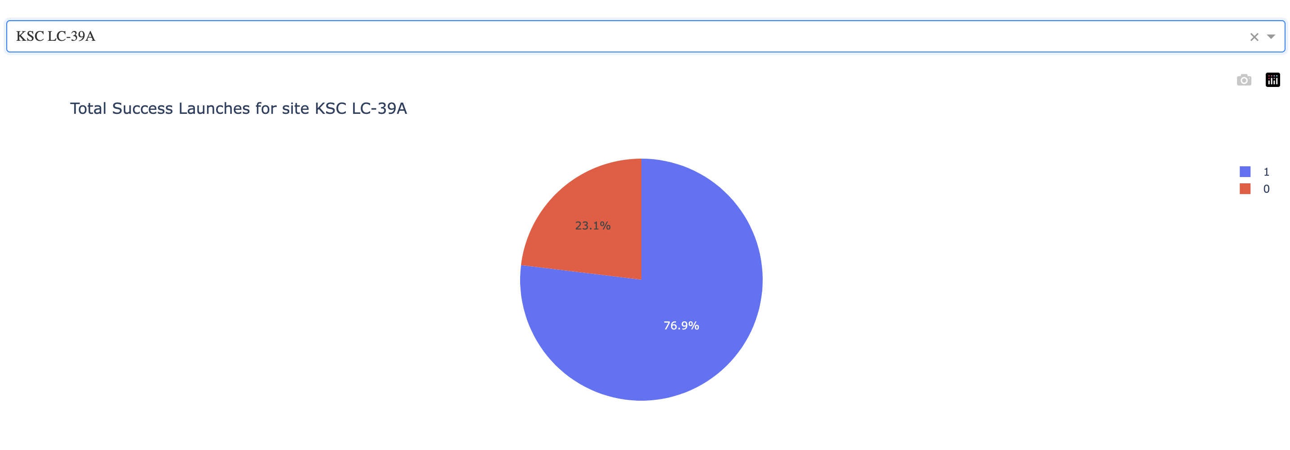
KSC LC-39A has the highest successful rate which is 76.9%

Slide 41
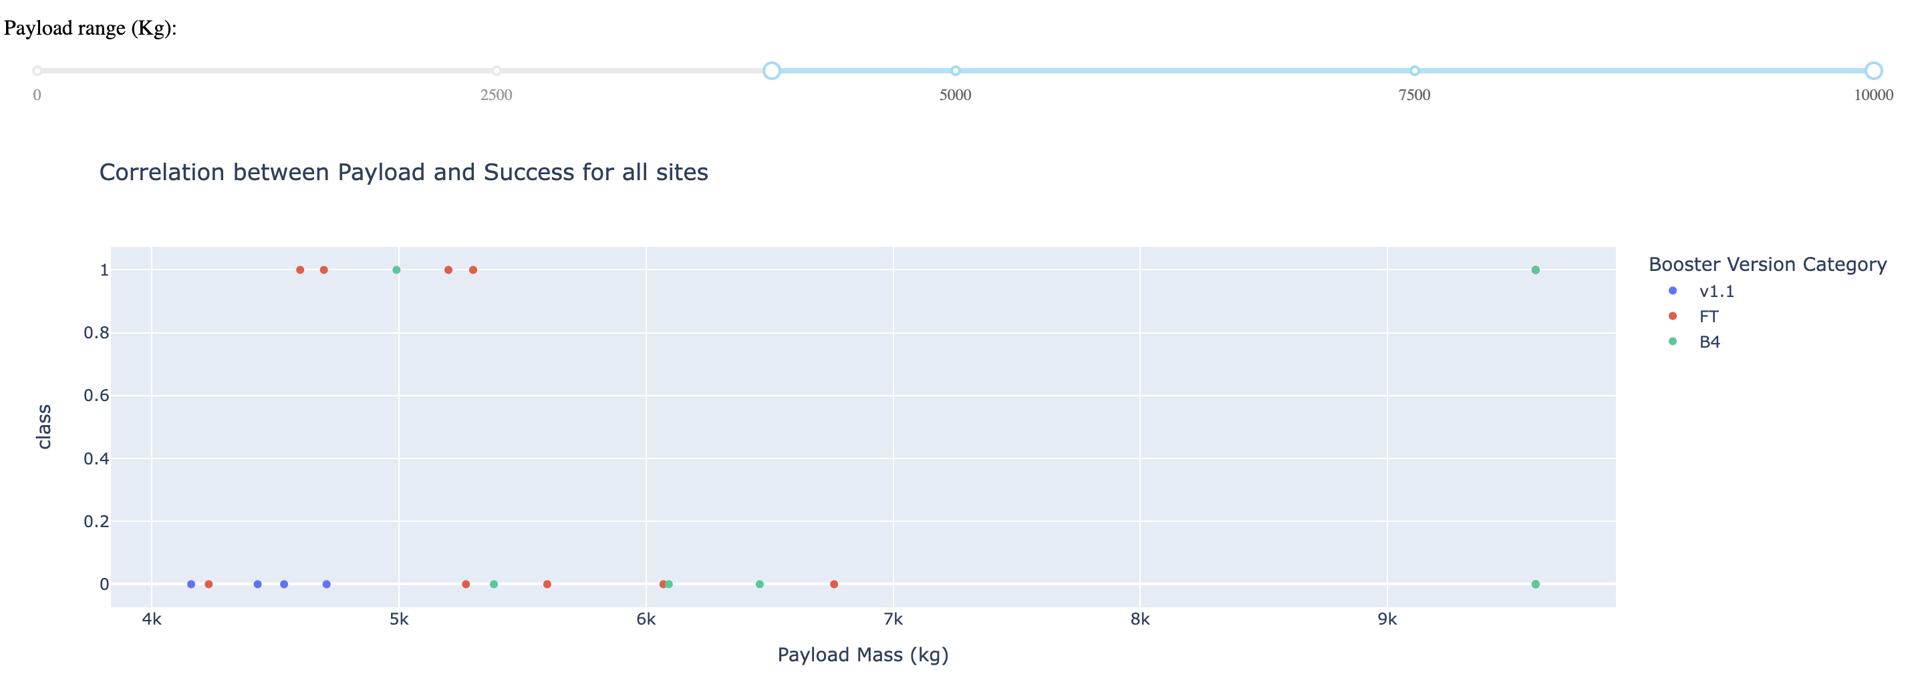
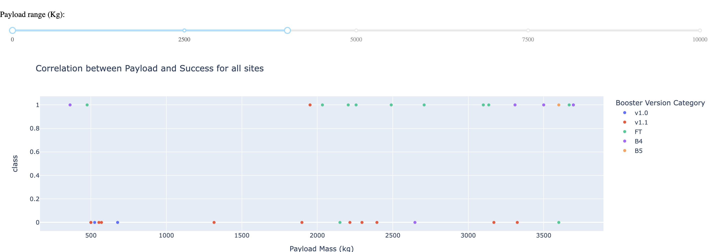
Payload vs launch outcome
The successful rate of lighter Payload is higher than heavier Payload
From 4000KG to 10000KG
From 0KG to 4000KG

Slide 42

Section 5

Slide 43
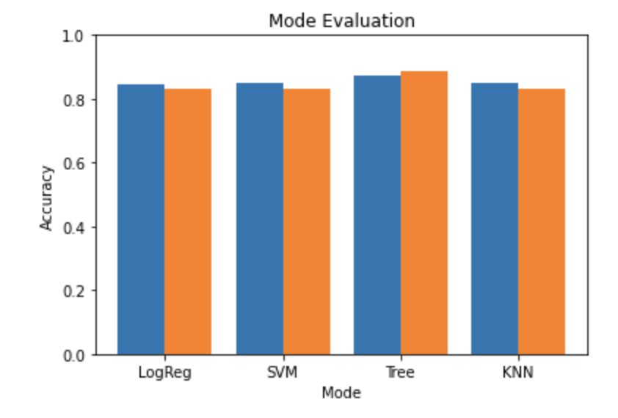
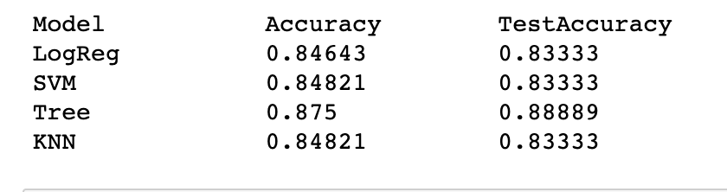
Classification Accuracy
Decision tree mode has the highest classification accuracy

Slide 44
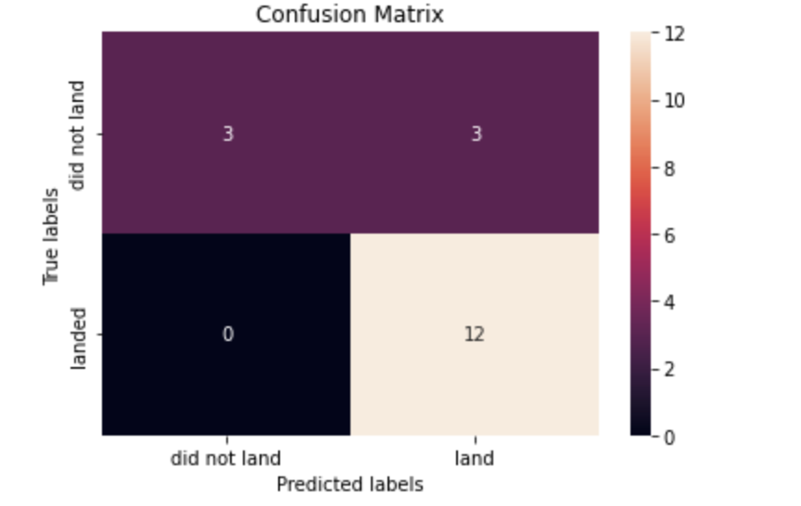
Confusion Matrix
It is the Confusion matrix of Decision Tree. It proves accuracy by showing the big numbers of true positive and true negative compared to the false ones.

Slide 45
Conclusions
Decision tree mode has the highest accuracy
The site with the highest percentage of successful launches is KSC LC-39A(41.7%)
Launch success rate increased significantly in 2013 till 2020
ES-L1, GEO, HEO, SSO have the highest success rate
The successful rate of lighter Payload is higher than heavier Payload
The larger number of flights at a launch site, the great successful rate for the next time of the same launch site

Slide 46


